Slide 1
Statistics 367-1-4361 Models
Opher Donchin

Slide 2
2A Review

Slide 3

Data is uncertain and imperfect
Data updates models
Probability quantifies uncertainty
Probability distributions have parameters
Conditional probability gives Baye’s rule

Slide 4
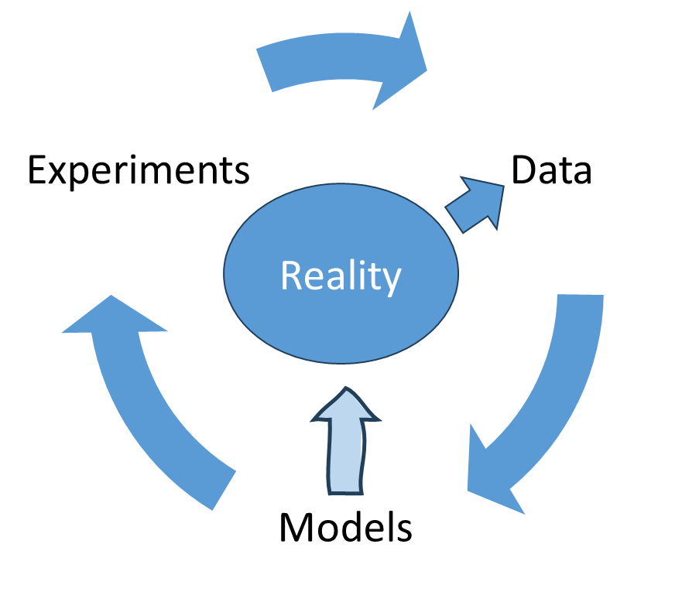
Data is uncertain and imperfect
Data updates models
Probability quantifies uncertainty
Probability distributions have parameters
Conditional probability gives Baye’s rule

Slide 5
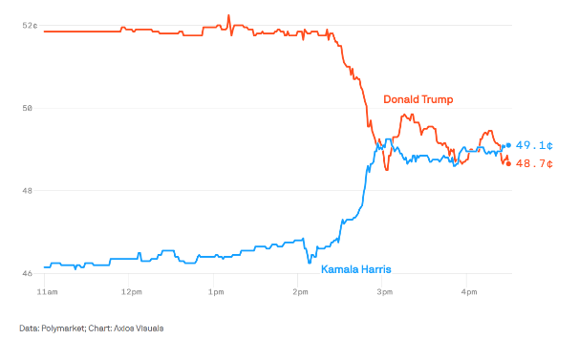
Data is uncertain and imperfect
Data updates models
Probability quantifies uncertainty
Probability distributions have parameters
Conditional probability gives Baye’s rule

Slide 6
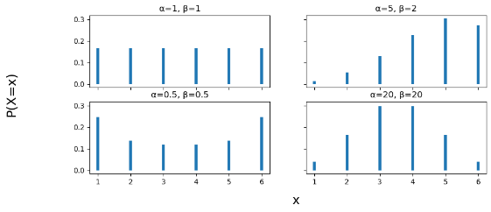
Data is uncertain and imperfect
Data updates models
Probability quantifies uncertainty
Probability distributions have parameters
Conditional probability gives Baye’s rule

Slide 7
Data is uncertain and imperfect
Data updates models
Probability quantifies uncertainty
Probability distributions have parameters
Conditional probability gives Bayes’ rule

Slide 8
2B Models

Slide 9
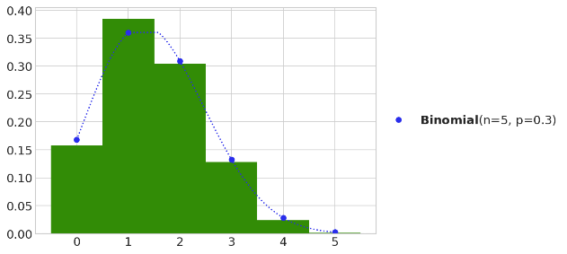
What is a model
A model says how reality might generate data
A particular distribution
With specific parameters

Slide 10
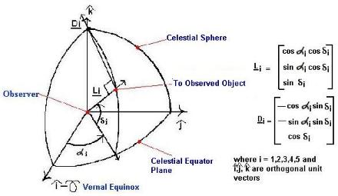
A brief history of models
Early researchers realized noisy data could be used for estimation
Laplace used Bayes’ rule (1812)
Estimate parameters of planetary orbits
Explicit mathematical model and inverse probability
Observations

Slide 11
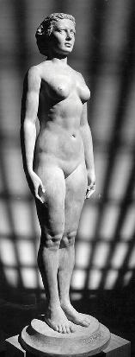
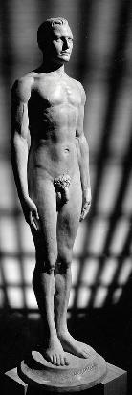
A brief history of models
Stepping away from models
Models made sense for physical sciences
Racial “scientists” wanted to estimate abstract relations
Adolphe Quetelet (1835) estimated height of “average man”
Francis Galton (1869) : correlation of head size and intelligence
Karl Pearson (1890) : optimal estimates given noisy data
Frequentist statistics focuses on the behavior of “estimators”
There is no “average man”

Slide 12
Reality, Data, and Models
Data
Estimator
Experiments
Parameter

Slide 13
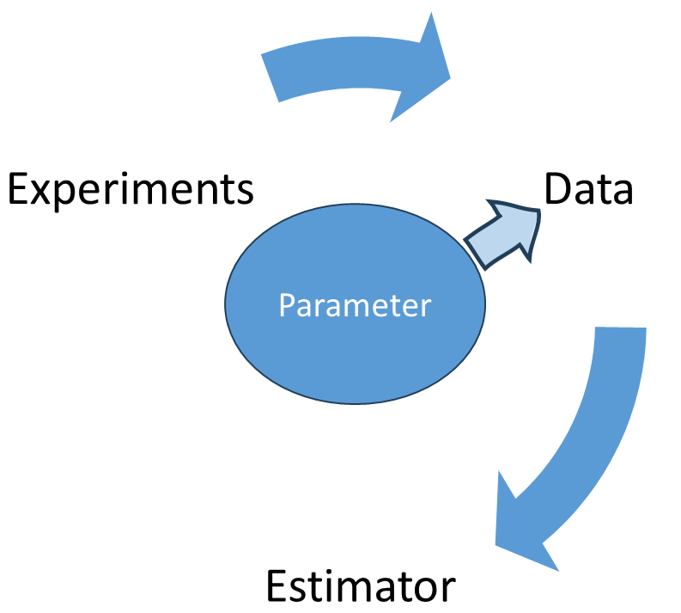
A brief history of models
Stepping back towards models
Ronald Fisher
The Design of Experiments (1935)
The search for objectivity
For selling race theory as “scientific” and “objective”
Maximum likelihood estimation
A tool for estimation
Likelihood

Slide 14
A brief history of models
Embracing models
Harold Jeffreys
Theory of probability (1939)
Working on internal structure of the earth from seismic waves
Update beliefs in light of data
Models as a repository for our current understanding
Parameters always have uncertainty
They are random variables

Slide 15
What is a model?
A model is an idea of how data is generated
It has:
Probability distributions
Parameters
Model examples:
The cookie jar
Movies

Slide 16
What is a model?
A model must be informed by data
Learning about the world must teach you about the model
Model examples:
The cookie jar
Movies

Slide 17
2C Bayes rule

Slide 18
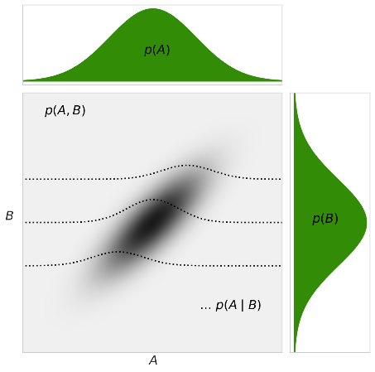

Bayes rule

Slide 19
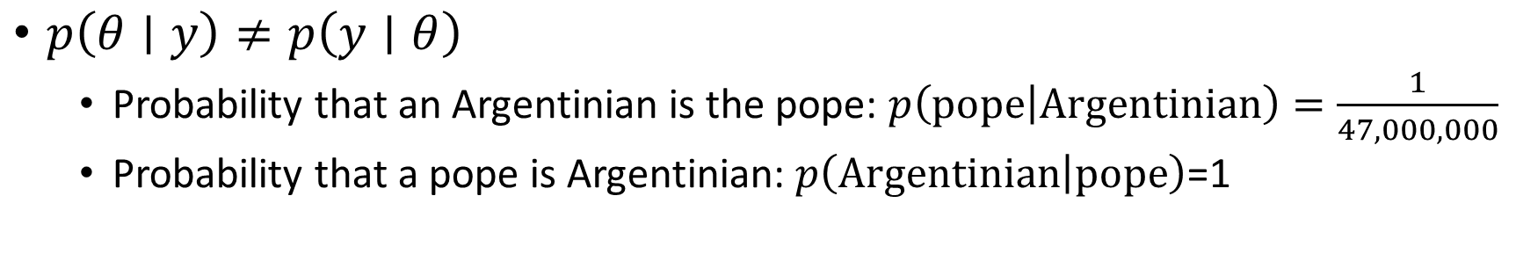
Baye’s rule can be counterintuitive
$p\left(θ∣y\right)≠p\left(y∣θ\right)$
Probability that an Argentinian is the pope: $p\left(\text{pope} | \text{Argentinian}\right)=\frac{1}{47,000,000}$
Probability that a pope is Argentinian: $p\left(\text{Argentinian} | \text{pope}\right)$=1

Slide 20
Applied to data and models

Slide 21
We will use Baye’s rule to update our models

Slide 22
Each component has a name

Slide 23
2C The bias of a coin

Slide 24
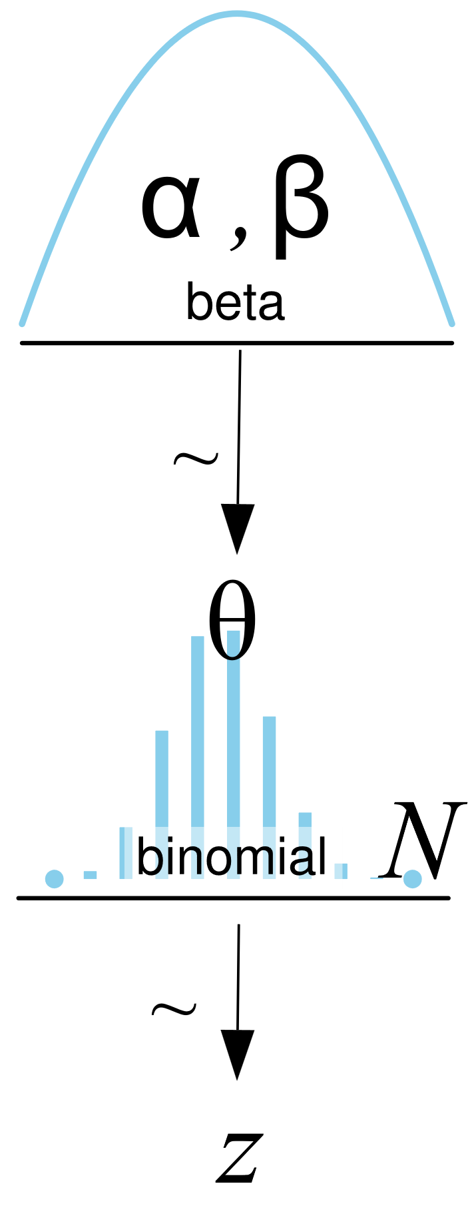
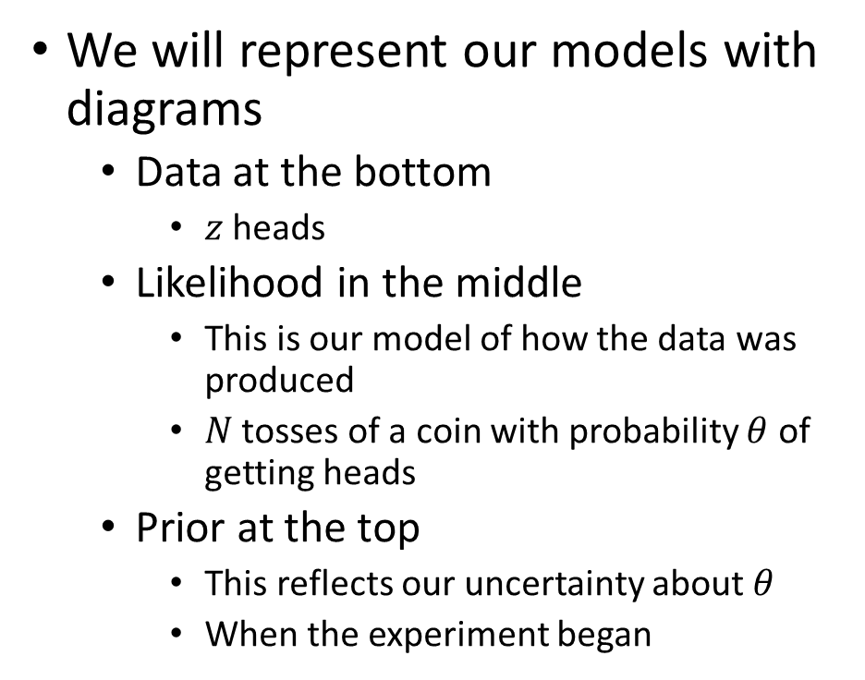
Model pictue
We will represent our models with diagrams
Data at the bottom
$z$ heads
Likelihood in the middle
This is our model of how the data was produced
$N$ tosses of a coin with probability $θ$ of getting heads
Prior at the top
This reflects our uncertainty about $θ$
When the experiment began
Prior
Likelihood
Data

Slide 25
Likelihood

Slide 26
The likelihood function
Probability of data given the parameter
This is a probability
For a coin with probability $θ$, the Bernoulli distribution

Slide 27
The likelihood function
Probability of data given the parameter
For a coin with probability $θ$, the Bernoulli distribution
For multiple flips, the Binomil distribution

Slide 28
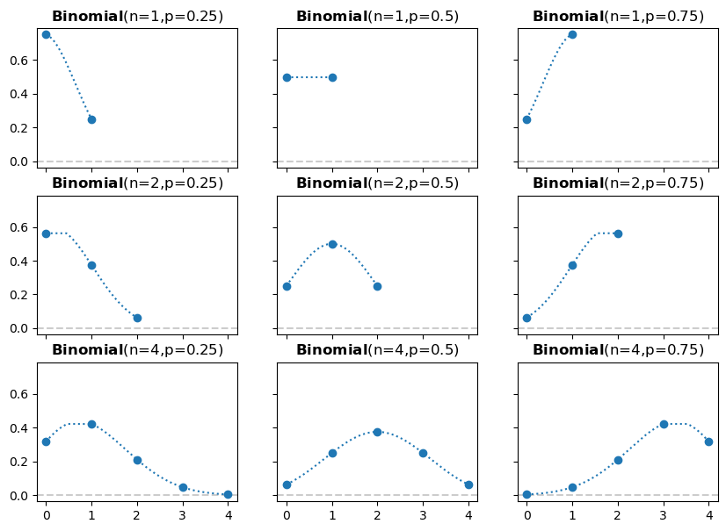
The binomial distribution

Slide 29
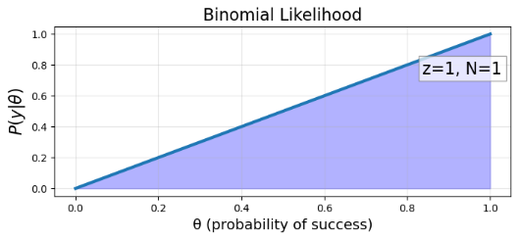
Coin flip experiment

Slide 30
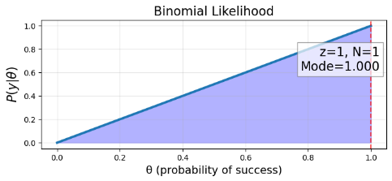
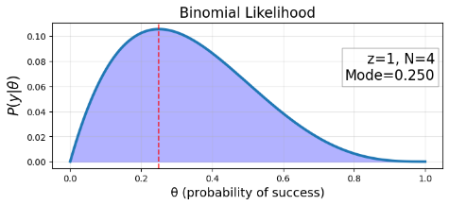
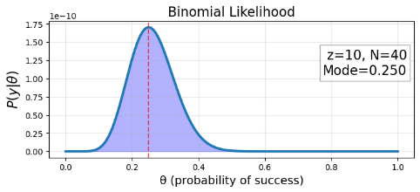
Multiple coin flips

Slide 31
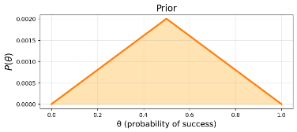
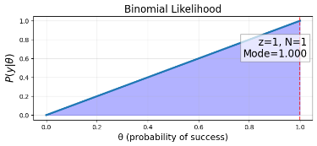
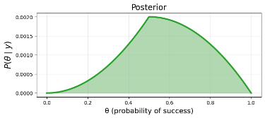
How will Bayes work?
Essentially, we simply multiply prior and likelihood
To get posterior

Slide 32
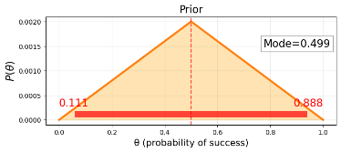

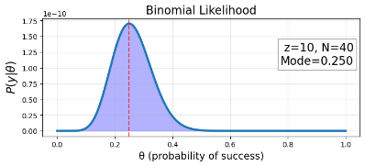
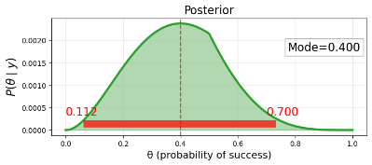
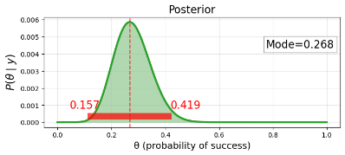
Changing the likelihood
As we add more data, the data will dominate the prior

Slide 33
Prior

Slide 34
The prior is a probability distribution
Must integrate to 1

Slide 35
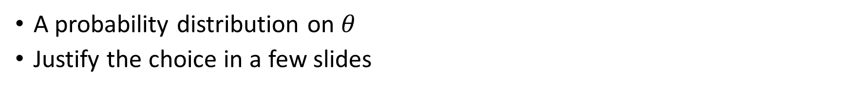
Use the Beta distribution for a prior
A probability distribution on $θ$
Justify the choice in a few slides
The beta distribution:
The beta function:
The gamma function generalizes the factorial:

Slide 36
Use the Beta distribution for a prior
A probability distribution on $θ$
Justify the choice in a few slides
The beta distribution:
The beta function:
The beta function normalizes the beta distribution:

Slide 37
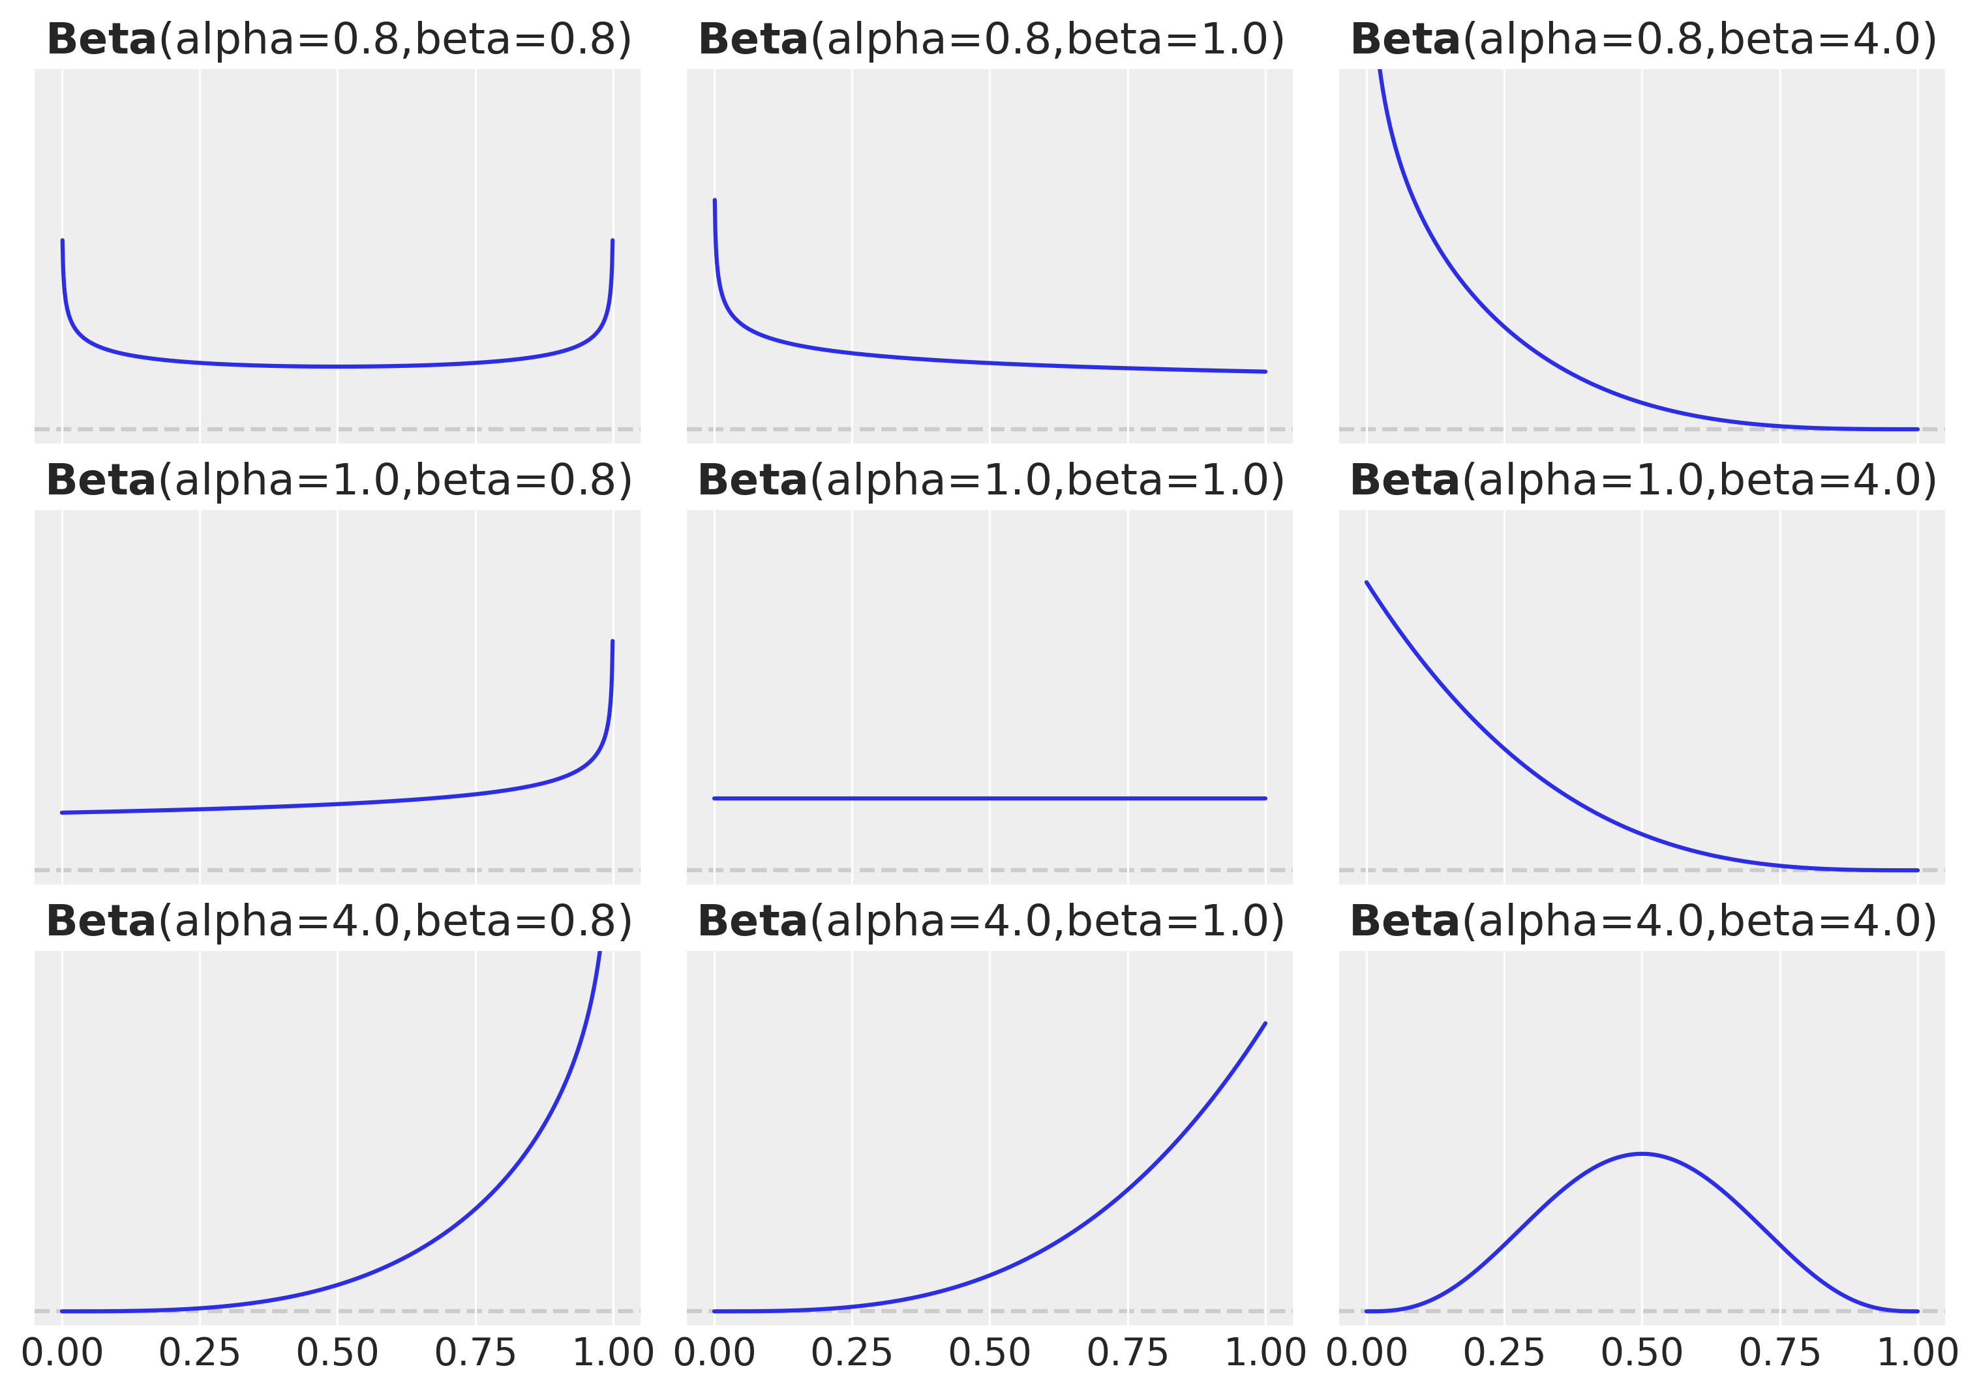
What does the Beta distribution look like?
A large variety of possible types of “plausible” probabilities

Slide 38
Why use the beta distribution as a prior for the binomial likelihood
Range of 0 to 1 makes sense for probility
Flexibility to represent many possible priors
The beta distribution is a conjugate prior for the binomial likelihood
A conjugate prior for a likelihood:
A family of priors where the posterior will also be in the family.

Slide 39
2D Conjugate Priors

Slide 40
The beta distribution is a conjugate prior for the binomial likelihood
We can use Bayes to find the posterior
Prior:
Likelihood:
Evidence:
Posterior:

Slide 41
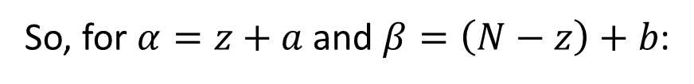
Finding the posterior analytically
Simplifying the numerator
2
Recall the definition of the beta distribution:
1
3
So, for $α=z+a$ and $β=\left(N−z\right)+b$:

Slide 42
Finding the posterior analytically (2)
The numerator is a beta distribution
3
4

Slide 43
Finding the posterior analytically (3)
The evidence is an integral
4
5
6
7

Slide 44
Finding the posterior analytically (4)
The integral is actually the integral of the beta distribution
Which integrates to 1 like all distributions
7
8

Slide 45
Finally proving that the beta distribution is a conjugate prior
The posterior is also a beta distribution
4
8
9
10

Slide 46
Analytic solution to Bayesian estimation
If the prior is a Beta distribution
Then the posterior is a different Beta distribution

Slide 47
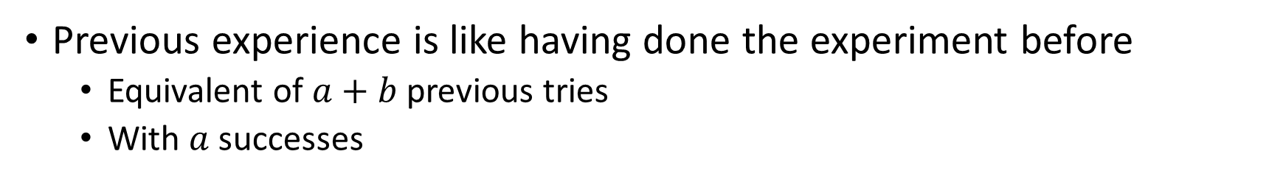
Interpreting a conjugate prior
Previous experience is like having done the experiment before
Equivalent of $a+b$ previous tries
With $a$ successes

Slide 48
2E Finding the posterior

Slide 49
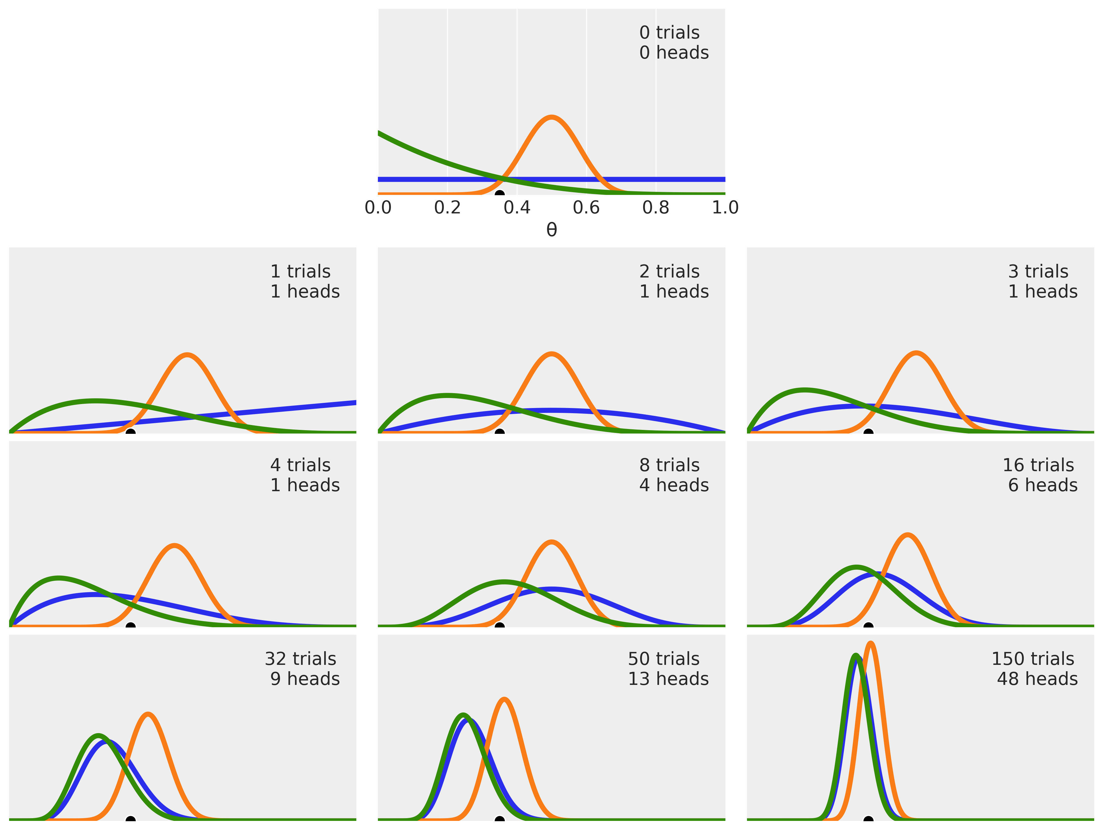
Apply this to coin flipping
Imagine three different priors
Uniform prior: a=1, b=1
Prior for unbiased: a=20, b=20
Positive skewed prior: a=1, b=4
Can you tell which is which?

Slide 50
Flip your first coin
Imagine three different priors
Flip a coin, get a head
Update the posterior

Slide 51
Flip your second coin
Imagine three different priors
Flip two coins, get one head
Update the posterior

Slide 52
Flip your third coin
Imagine three different priors
Flip three coins, get one head
Update the posterior

Slide 53
Keep flipping coins

Slide 54
Code for previous figure
Do the analysis
Set up the data
for idx, N in enumerate(n_trials):
if idx == 0:
plt.subplot(4, 3, 2)
plt.xlabel('θ')
else:
plt.subplot(4, 3, idx+3)
plt.xticks([])
y = n_heads[idx]
for (α_prior, β_prior) in beta_params:
posterior = pz.Beta(α_prior + y, β_prior + N - y).pdf(x)
plt.plot(x, posterior, lw=4)
plt.plot(theta_real, 0, ms=9, marker='o', mec='w', mfc='k')
plt.plot(0, 0, label=f'{N:4d} trials\n{y:4d} heads', alpha=0)
plt.xlim(0, 1)
plt.ylim(0, 12)
plt.legend()
plt.yticks([])
plt.figure(figsize=(12, 9))
n_trials = [0, 1, 2, 3, 4, 8, 16, 32, 50, 150]
n_heads = [0, 1, 1, 1, 1, 4, 6, 9, 13, 48]
theta_real = 0.35
beta_params = [(1, 1), (20, 20), (1, 4)]
x = np.linspace(0, 1, 2000)

Slide 55
Many things to learn from this figure
A Bayesian analysis leads to a distribution
Mode of distribution gives most probable value
Spread of distribution gives uncertainty
More data leads to:
Less spread, less uncertainty
Converging posteriors, agreement on most probable value
Some priors are equivalent even with small amounts of data

Slide 56
One more thing to know
We could add the data in different orders
The final result would be the same

Slide 57
2f Frequentist vs Bayesian

Slide 58
Bayesian analysis requires a prior
Using a prior has advantages:
It allows us to do Bayesian analysis and get a posterior
The posterior is a distribution that shows how credible different possibilities are
The posterior allows us to characterize our uncertainty
Posteriors average over priors
This means taking into account different possibilities
Makes conclusions more robust
Priors can regularize our results
That is, they allow more efficient and robust inference
Less overfitting (we will talk about overfitting)
Thinking about a prior requires you to think about the problem

Slide 59
Frequentist analysis rejects priors
Frequentists wanted an objective approach
Everyone must reach the same conclusion
No matter how weak the evidence
No prior means no distribution
Frequentist approaches focus on estimation
The idea is to find the best estimate
Often there are many choices

Slide 60

Maximum likelihood estimation
For $\hat{θ}$: the derivative is 0

Slide 61
Maximum likelihood estimation (2)
Solve for $θ$

Slide 62
The frequentist estimate through Bayesian eyes
Choose a uniform prior
Take the mode of the posterior and throw away the rest
Assume uniform prior
End up with maximum likelihood esitmate

Slide 63
The frequentist estimate through Bayesian eyes
Frequentism does choose a prior
Just not always the best one
Maximum likelihood is a summary of the posterior for this prior
Just not always the best one
Frequentism is like do Bayesian statistics badly

Slide 64
2g How to choose priors

Slide 65
The history of choosing priors
1930s-1950s: Objective priors
Choose according to a mathematical principle
1960s: Maximum entropy priors
Minimize extra information given constraints
1980s-1990s: Vague priors
Make priors broad enough that they do not matter
This is the frequentist approach
2000s: Empirical priors
Base priors on data
2010s: Weakly informative priors
Stabilize analyses
2020s: Automatic prior selection
Choose according to a mathematical principle

Slide 66
Choosing strong priors
In many hard problems, strong priors make sense
Election polling
Weather prediction
Genetics
Strong priors are necessary when there is weak data
Strong priors are inappropriate when there is strong data
Unless you don’t trust the data
Like in election polling

Slide 67
Prior elicitation
Approaches for translating expert knowledge into prior distributions
What questions does it make sense to ask an expert?
How can you take their answers and create a prior distribution?
How can you iterate this process to converge to a prior distribution that truly reflects the expert knowledge

Slide 68
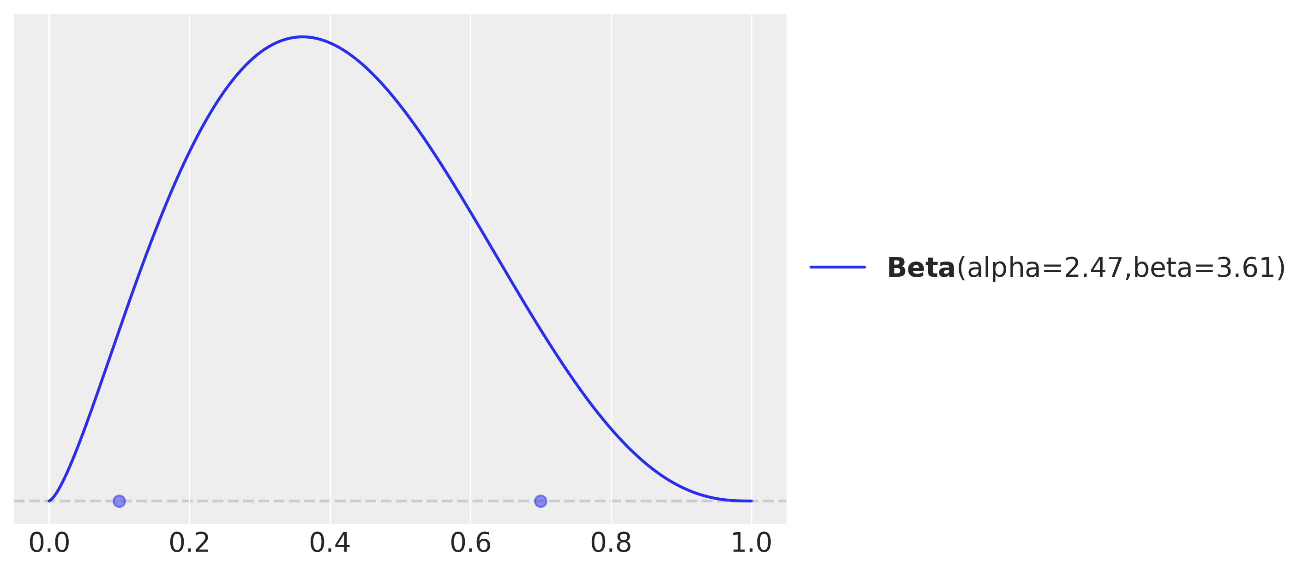
Preliz: a package for prior elicitation
I’m pretty sure the coin’s probability is somewhere between 0.1 and 0.7
maxent finds a Beta prior with X% of the probability between low and high
And displays it
import preliz as pz
dist = pz.Beta()
pz.maxent(dist, 0.1, 0.7, 0.9)

Slide 69
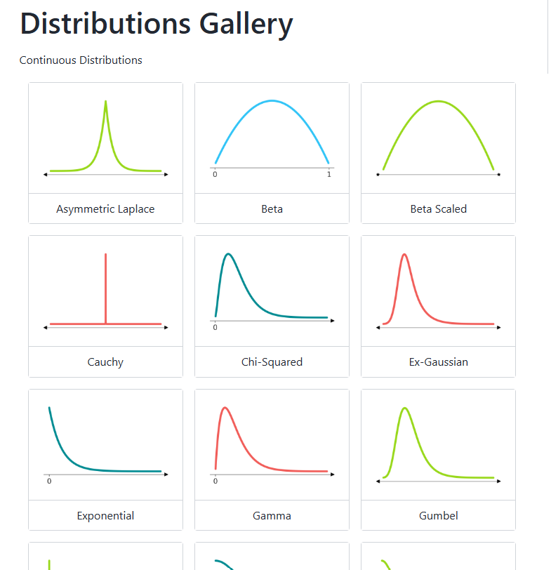
Preliz is handy for learning distributions
See the full gallery here:
https://preliz.readthedocs.io/en/latest/gallery_content.html
We will use many of these distributions.
This is a great reference
And it can also help in prior selection

Slide 70
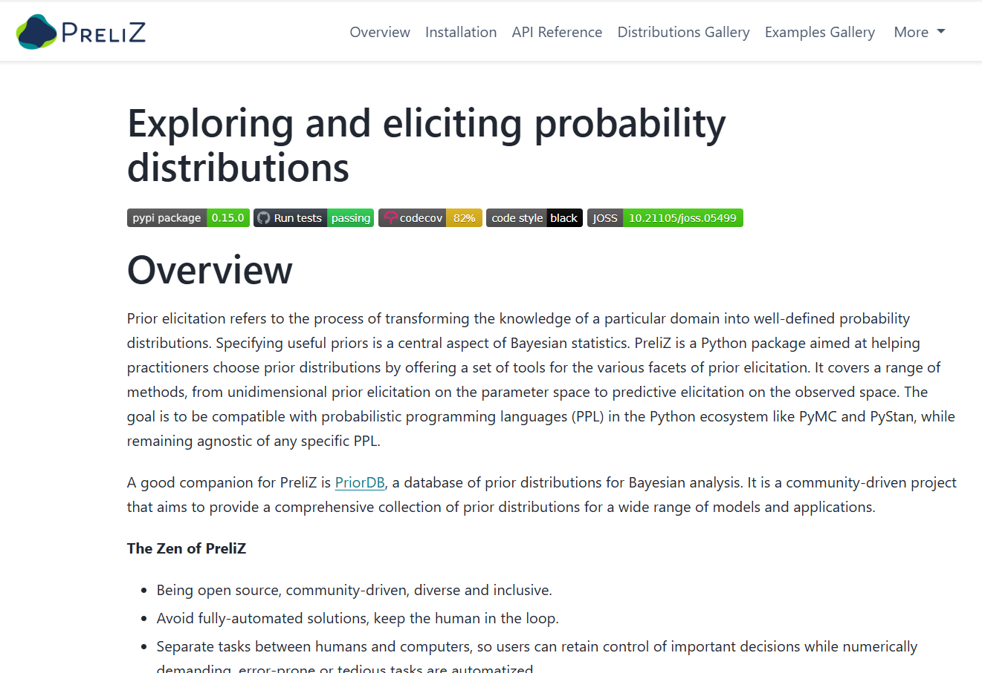
Preliz home page
https://preliz.readthedocs.io/en/latest/index.html

